Slide 1

Active Security
Ryan Hand, Michael Ton, Eric Keller
Notes:
Good morning, my name is Ryan Hand and on behalf of myself and my co-authors, Michael Ton and Eric Keller, I am here to present on Active Security.

Slide 2
Defending Cyberspace?
50
percent of APT attacks targeted aerospace & defense, ICS, financial, computer hw/sw
243
median # of days attackers went undetected inside organizations
63
percent of victim organizations were notified by an outside entity
77
percent of attacks in 2011 used publicly available malware
2
Notes:
Regardless of what field of computer science or computer systems and engineering you work in, it is safe to say that security is a major concern.
Over the past several years we have seen the attack frequency and level of sophistication sharply increase, and just last year 50% of persistent attack campaigns targeted our most important industries.
Worse is the fact that they have been extremely successful at hiding their presence.
And more times that not, we are the last to find out about our own compromise.
In fact, it was just recently reported that a well-known hacker collective has been on a year long campaign, exploiting DoE, Dept. Health Human Services, and military systems.
Just 2 years ago, we saw that 3/4 of these attacks used publicly available malware and tools. This means that we defenders were armed with the same information that the attackers had

Slide 3
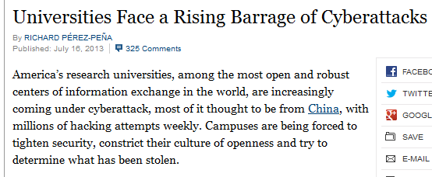
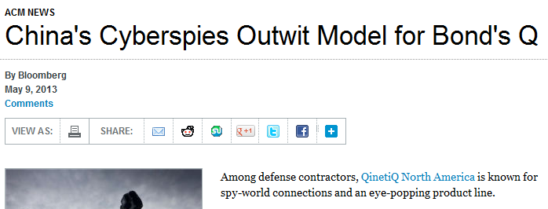
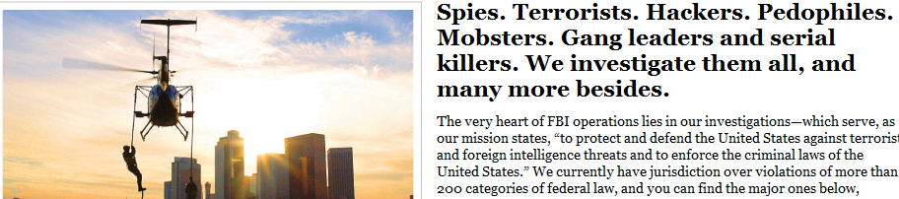
Making the News
3
Notes:
The good news is that media has begun to latch on to these trends
And we are seeing an unprecedented level of importance expressed by our federal law-enforcement, intelligence, and defense agencies on the matter of cyber security.
The FBI has listed cyber crime as their number 3 priority directly behind terrorism and counter-intelligence.
Recent articles show that attackers are exploiting networks in as many ways as there are diverse technologies.
Now more than ever, we must be able to detect attacks, attribute them to persons or organizations, and ultimately prevent the future ones.
So with an increase level of importance in industry, training and certification authorities, government, and academia, why do we continue to be the victim?
We argue that our current defense models and strategy all but ensure that we always be one step behind our attackers.
So what's the problem?

Slide 4
“Working in Nested Isolation”
Problem 1
Policy, procedures, awareness
Physical
Perimeter
Network Internal
Data
End-Point
Apps
“Stove-piped” functionality in implementation
Digital Forensics / Incident Response
Limited “context-aware” programmability
Giving managers a false sense of security
Lost information and very limited disclosure
Can be especially disjoint in multi-vendor environments
4
Notes:
The security model you see here shouldn't be entirely, if at all foreign. This is the traditional "defense in depth" model that gives security managers and personnel a guide to holistic security.
-Our two outer layers of policy, procedures, and awareness, and Physical security primarily address the human element of the workplace and our ability to limit direct access to network resources by unauthorized personnel
-Our 5 deeper layers refer primarily to the security of systems hardware and software implemented throughout an enterprise.
Theoretically this model could work very well yet, when we procure and implement systems that embody each layer, we see a stove piping of functionality where each layer performs duties with limited awareness of an overall state of security.
We see an inability to learn from the environment and actively protect or seek new information to form better perspective.
-This 2-dimensional view of our security state instills a false sense of security through a "check the box" procedural stance which illustrates problem number one which we refer to as, "Working in Nested Isolation".
-Unfortunately this isolation can be compounded in multi-vendor environments. This does not mean that we expect an enterprise to sole source its security!!! But we must evolve our overall strategy.
-All of this aside We also fail to address that digital forensics are often performed after the fact in the incident response process, likely after the adversary has had a chance to clean up. And when we need it we outsource it, and disclosure by organizations of these events is a problem in of itself.
-Why not fully leverage the information that is provided by our network and end systems? Why not do it in real-time?
-Our solutions decompose to patching systems, and updating AV and IDS signatures, blocking traffic, white or blacklisting IPs and websites, and then crawling under our desks hoping we aren't the low hanging fruit.
-To further understand why this isn't an effective system of defense, I'd like to introduce a concept borrowed from our military that illustrates our second main problem.

Slide 5
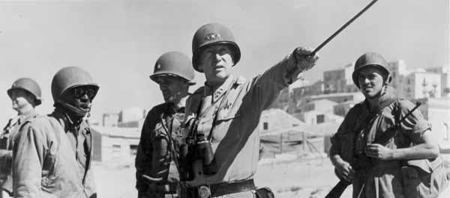
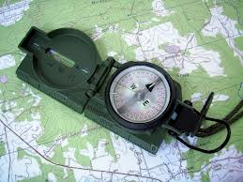

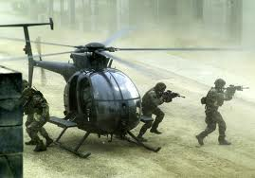
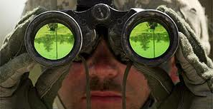
OODA Decision Feedback Loop
Decide
Orient
"Time is the dominant parameter…”
We’re working at human reaction speed
Problem 2
Act
Observe
5
Notes:
The OODA loop was introduced by US Air Force fighter pilot and renowned pentagon military strategist, Col. John Boyd in 1976, presents a decision making feedback loop previously applied to military operations. OODA stands for Observe Orient Decide Act:
Observe: wherein we collect data and information based on input from our senses and information fed from events currently unfolding
Orient: where we analyze and synthesize the data to form perspective or context
Decide: based on the data and context, we form a hypothesis and choose a course of action
Act: we then physically implement the course of action
And ultimately we reenter this cycle, constantly assessing and reassessing a situation and our surroundings as they unfold.
These principles can and have been applied to many areas of military strategy and business, and Boyd's concept even inspired research projects that produced the lighter weight, more maneuverable fighter jets of our time including the F-16 and F/A18, still in service today.
Quoted from a fellow fighter pilot of the time,
"Time is the dominant parameter. The pilot who goes through the OODA cycle in the shortest time prevails because his opponent is caught responding to situations that have already changed."
This statement illustrates very well the idea that both defenders and attackers go through this cycle, and those who force their opponent to be reactive are the winners.
In this same way, we wish to quicken our reaction speed and, when possible, "get inside the opponent's cycle" by disrupting their decision making process and forcing them to react to a changing environment that WE CONTROL.
Unfortunately, today we as defenders of the network still operate at human reaction speed which is problem number two.
To help solve this, we introduce Active Security

Slide 6
Active Security
A defense framework that seeks to:
Intelligent context awareness
Programmatic automation
Consistent security posture across the infrastructure
Achieve real-time reaction speed from detection to remediation
6
Notes:
So, we have run into two major problems:
First, our current security models operate in isolation with limited ability to view an attack from many perspectives at once, which becomes even tougher to do in a multi-vendor environment
AND
Second we currently react and adapt to our environment at human reaction speed which almost will always assure that the enemy has the upper
hand.
We introduce Active Security as a defense framework that cuts across the layers of traditional security models to provide
- intelligent context awareness of the network security state
- programmatic automation of a variety of security functions,
- consistent security posture across all sensors in the infrastructure through reconfiguration
- and "faster than human" reaction speeds from the detection to remediation phases

Slide 7
Active Security OODA Loop
Orient and Decide
Programmatic Control
Network Artifacts
Parsed Intel
Forensic Analysis
Act
Observe
Alter Network Config / Gather Information
Sensor/Device Information
Security Devices
End systems
Network Devices
7
Notes:
To realize this OODA concept we envision a security controller that exercises programmatic control.
Applying the OODA concept, we see this as a continued cycle of observing sensory and configuration data from a multitude of device messages, traffic of interest, and alerts.
The intelligence lies in the controller where our ORIENT and DECIDE phases of the OODA loop occur. From here, we may decide to gather further information from adjacent sources to get a better perspective, or we may decide alter the network configuration based on a flaw we have discovered.
Information gathered may also be subjected to forensic analysis where we take network artifacts and seek to obtain parsed intelligence to better ORIENT the controller to the current network state and aid decision making to better protect the network or attribute an attack.

Slide 8
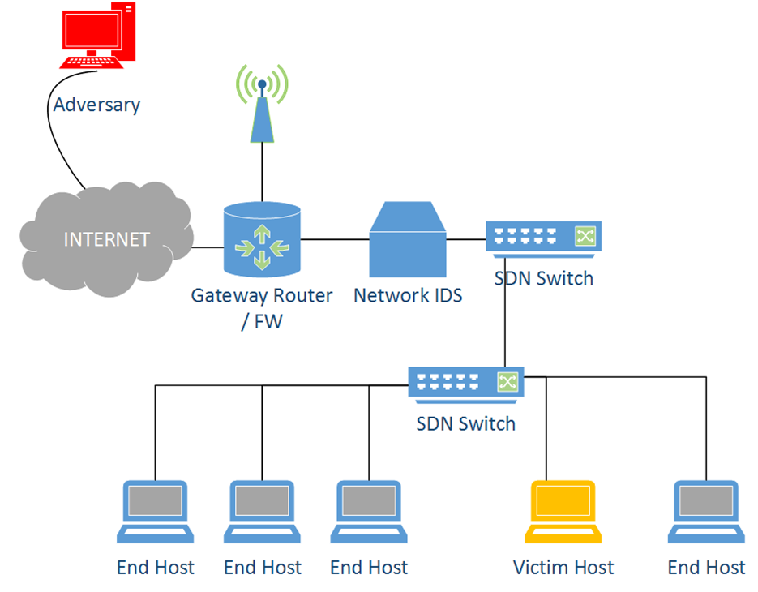
Simple Attack Scenario
Remember!! In 2012, median # of days attackers went undetected inside organizations = 243…
2. Malicious file is opened by user and attempts to “call home”
3. Firewall blocks egress traffic violation
1. The attacker uses a spoofed email from a “trusted party” as an attack vector.
4. What we didn’t see… and won’t until forensics / IR
“Oh look, an email from Alice!”
8
Notes:
Consider a simple attack scenario where we assume that our perimeter has been compromised.
We have an adversary who has delivered a malicious client-side exploit via email, spoofed to appear to have come from a trusted party.
For added realism, we implemented a simple binary obfuscation technique to bypass 31 different anti-virus products, as these provide a false sense of security today.
Upon opening the email attachment, the exploit payload attempts to establish a communication channel with a command and control server ultimately delivering the attacker control.
Fortunately for our poor network administrator, we have configured our firewall to scrutinize egress traffic from our internal network. A couple things could occur here, but typically we see the active blocking of traffic from this suspicious host until examined further by a person.
We know that simply examining a firewall rule violation will give us only a small piece of the picture here.
AND unfortunately, we may never see that this malware, once executed, sought to also exploit adjacent hosts laterally on the internal network over common service ports.
Working at human reaction speed, and possibly with few dedicated security personnel, this additional investigation into the cause of the firewall rule violation could take a significant amount of time, and, if trained personnel are not readily available may never happen or may be written off as a false positive.
Let's not forget the median number of days that we said attackers went undetected in our networks in 2012.
Lets not forget that both our IDS and our end-host systems both missed this anomalous traffic trying to exit our network.
This illustrates that we may have an inconsistent security posture across our various sensors in the network, possibly just due to poor configuration.
So, here we can begin to see why forensic evidence preservation and timely response are incredibly important to attribution, evidence preservation, and providing better protection in the future.
Let's take a look at how we have envisioned this system

Slide 9
Active Security Architecture
Active security controller
Operator Interface
Security Applications
Control Platform
Plug-ins
Sense (detection)
Collect (forensics)
Adjust (configure)
Counter (attack, recon)
Controller to infrastructure communication channel
Security devices -----------
e.g. IDS firewall
End-hosts
---------------
e.g. server, smart phone
Network devices ----------------------- e.g. routers, switches, WAP
Cyber Infrastructure
9
Notes:
This is a basic depiction of our Active Security architecture where the top box represents our security controller and its components and the bottom box represents the computer network infrastructure we are defending.
We begin with a set of running active security applications that describe what information to use, synthesize it, and decide what actions to take.
The key to allowing this to be an extensible and modular framework is through the use of a variety of plugins, that represent the 5 core capabilities described in our paper.
The first of which is SENSE. Here we wish to interface with a wide variety of sensors on the network. These include the plethora of security devices out there but certainly must not be limited to these. Our end-hosts and network devices capture a great deal of the picture for us as well.
The next capability is COLLECT. We argue that active, in-attack forensics is necessary to speed our feedback loop by capturing information that falls into two main categories.
- Information useful for damage assessment, attribution to an individual or organization, and evidence preservation.
Information useful for better protection (reference back to OODA loop forensics)
The next 2 capabilities of PROTECT and ADJUST may be described together as they both relate to better protecting the network through reconfiguration of equipment as we discover security holes, and also adjusting the network state to disrupt an attacker's reconnaissance and exploit development lifecycle (attacker's OODA loop). As described in the active security OODA loop slide, here we are forcing the attacker to become reactive which gives the defender the advantage.
Finally, we describe the potential need or desire for an organization to COUNTER through reconnaissance as an attack is occurring, or a subsequent counter-attack of sorts to thwart an attack that may seek to consume your resources

Slide 10
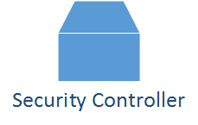


Attack Scenario Revisited
*COLLECT*
*Sense*
*Adjust*
10
Notes:
Going back to our attack scenario where we have seen our perimeter defenses successfully block an outgoing network connection to a Command and Control server, but subsequently propagate laterally within the network, we now introduce a few new components that were used during our actual prototype described in the paper. These include our security controller, separate secure storage for evidence preservation, and an internet proxy server.
With the added granularity of control through Software Defined Networking, we interface with our firewall to receive the alert and its pertinent information. **SENSE**
We identify the host in question, and in this situation, decide to recover physical memory from our victim host. **COLLECT**
We secure copy it back and after some analysis of the machine's running state, determine that several network sockets were opened at the time of the event and were directly related to the malware's running process. Among many other artifacts, found in volatile memory, we extracted the deobfuscated executable for static and dynamic program analysis in a safe environment.
Armed with this new information, we identify the additional hosts that may be compromised and initiate action accordingly, store the additional information for parsing and feed this back into our decision loop, blocking additional ports that have been probed by the adjacent machines, possibly routing these systems through an Internet proxy if availability is of concern, or quarantining the systems for further analysis.
Ultimately, we wish to reestablish normal operation on the network and reconfigure our perimeter defenses to recognize this previously unknown attack vector. **ADJUST**

Slide 11
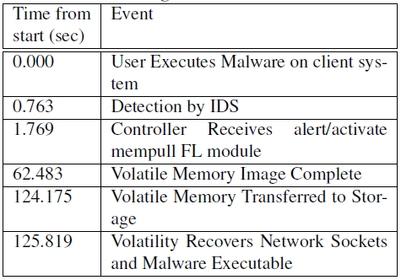
Prototype
Floodlight Software Defined Network Controller
Snort IDS
Linux Memory Extractor
Volatility
Future: use lightweight and stealth forensic methods
11
Notes:
So, in our prototype we implemented our security controller through a customized Floodlight SDN Controller module.
To the right, we have displayed the actual time of events during our trials. This illustrates the automated actions from execution of the malware, to the final parsing of forensic artifacts obtained from the victim host.
We wrote middleware (representing our SENSE plugin) to interface between the controller application and Snort IDS to process and deliver pertinent information to the controller application.
The controller took this information and activated our volatile memory imaging module, which in this case established secure communication with the victim, took a forensic image of RAM, and securely copied it back for preservation and parsing by Volatility.
This is just one example of a security application in our controller and realize that it is certainly beneficial to use other alternatives such as lighter weight actions that do not take a full copy of memory, perhaps looking for network connections or newly created registry keys, etc. The sky is the limit here and we have a great deal of experience in the forensic world to draw from to describe these actions and methods from a programming standpoint

Slide 12
Securing the Controller
Active Security Controller
Leverage existing technologies
Trusted boot (hardware based)
Verified and hardened Operating Systems
Modules written in safe languages
Network based enforcement and monitoring
Plug-in Modules
(Safe Languages)
Software Hardened OS
SDN Controller
Hardware Trusted Boot
Network
Systems
12
Notes:
A natural uneasiness comes from the fact that we have placed a high level of trust and control, in seemingly few places.
However, we envision our security controller as a compliment to a separate SDN controller to allow for appropriate separation of duties, that is, network alterations and flow related actions under the SDN controller, and security related actions and analysis to the security controller and communication between the two for information passing.
We can leverage existing technologies to address this issue.
-One benefit is that we realize our attack surface of a smaller number of controller systems will be narrow and thus may be closely focused upon. This obviously is not sufficient on its own.
Other technologies we examined include secure bootstrapping through the use of trusted platform hardware on our systems.
Formally verified and secure operating systems.
Choosing secure languages for our security plugin modules to be written in to prevent information leaks and allow us to verify module input information.
And we also want to ensure that the network devices that interface with the security controller are not exposed to additional threats. We can do this through secure communication channels between devices and through network based enforcement currently being used in SDN.

Slide 13
Conclusion and Future Work
System of security inspired by OODA feedback loop
Illustrated prototype of in-attack forensic collection
Explore expanded sensor diversity
Further examine controller security
Dynamically adjusting the network
Stealthy and efficient automated forensic analysis
13
Notes:
We envision this as a defender's framework to speed reaction time and gain the tactical edge over the attacker in an ever changing threat landscape.
Today we introduced a system of security, inspired by the Observe, Orient, Decide, Act feedback cycle and software defined networking.
- Interfaces with a diverse set of sensors
- Synthesizes the pertinent data to form a better perspective.
- Acts based on information available or may seek supplemental information
We also illustrated the value of collecting forensic data during an attack though the use of our prototype.
As numerous technologies continue to be developed, we wish to further expand the possibilities for greater sensor diversity, automated correlation, and the potential for automatically setting new sensors within the network on the fly to record or monitor data and traffic of interest.
For the FUTURE
Leveraging technologies that are being implemented in end-system security, OS security, safe languages, and security enforcement, we wish to further examine new methods of ensuring a high level of trust in our controller and sensor environments.
To proactively disrupt the attacker's OODA loop (exploit development and reconnaissance lifecycle) and better defend our own network, we wish to further examine the dynamic adjustment of the network infrastructure with SDN
We also wish to further examine new methods of efficiently capturing only the information pertinent to improving the security controller's perspective during forensics and remain undetected as best as possible.

Slide 14
Questions?
Thank you!
14

